Slide 1
Experience Design
Week 3 – User Study

Slide 2
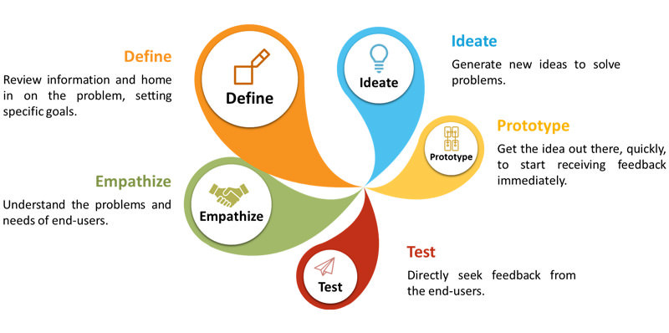
UX cycle
Weeks 7 & 8
Weeks 3, 4 & 5
Week 13
Notes:
Note: update!

Slide 3
User study agenda
Week 3
Why study (the user)?
User selection
User study techniques
Survey
Interview
Observation
Data analysis
Personas, user requirements capture
Week 4
Week 5
Notes:
Note: update schedule…

Slide 4
Topics in this presentation
Why study (the user)?
User selection
User study techniques
Survey
Resources
Week 3 – practical

Slide 5
WHY STUDY (THE USER)?
“Know thy user, and you are not thy user.”
— Arnie Lund
Notes:
Lund - a Principal Director of User Experience at Microsoft. PhD in experimental psychology: human learning and memory. Published widely in R&D management and on research in natural user interfaces.

Slide 6
Why do you need to study the user?
The ultimate goal – to understand user behaviors, needs, and motivations
To create designs that are relevant, easy and pleasurable to use
Remember:
You are not the user -> Look at product from user’s perspective!
Notes:
However, users may not be good at communicating their needs and may behave differently when you are around.
Find out what people actually do, what tasks they need to accomplish and the problems they encounter. Do not expect them to tell you what the solutions should look like. This is YOUR task!

Slide 7
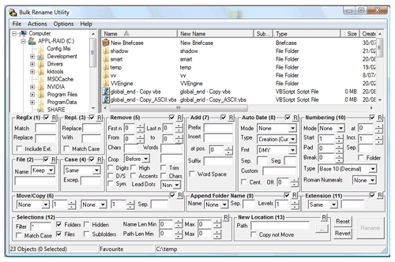

What could happen if you do not study your users?
Notes:
Software engineers often design interfaces from their perspective, and this might not suit a common user. It could overwhelm them, annoy them, and sometimes even lead to the user abandoning the product and choosing another one with a better user experience from a competitor.

Slide 8
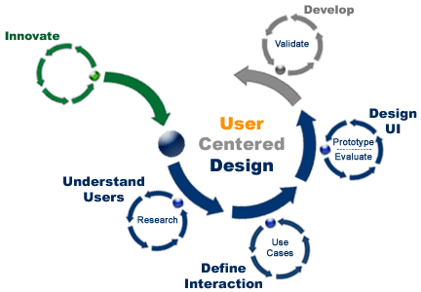
User-centered design
Notes:
Remember: You are not thy user!

Slide 9
Steps in conducting UX research
Objectives
Screen users
Fieldwork
Define a clear mission
Identify target users
Conduct studies on users
Analysis
Form personas, user requirements
Notes:
1. Objectives: To extract the most value from this research, you need to define a clear mission with concrete goals. This means formulating the right questions and setting up the scope for your work. Ultimately: What are you trying to solve and why?
2-4: explained in following slides
Note: Analysis could be deeper, resulting in more deliverables. But to keep it simple, we only form personas.

Slide 10
USER SELECTION

Slide 11

User selection
If you try to please everyone, you won’t please anyone!
Not all users need be your user!
Identify your target users – first step in understanding your users…
}

Slide 12
Target users
Defining and targeting a specific audience is the only way to craft the perfect user experience.
How would you define your target users (ideal users)?
Define a few important characteristics they should possess.
Examples: possession of a mobile phone, tendency to shop online, age, food preferences, etc.
Use these characteristics to pick users for your field studies.
Notes:
User profile: Define what you mean by “user”. Take a second to imagine the perfect consumer for your product. Define their characteristics in as much detail as possible.
You’ll use this user profile to help make every future UX design decision.

Slide 13

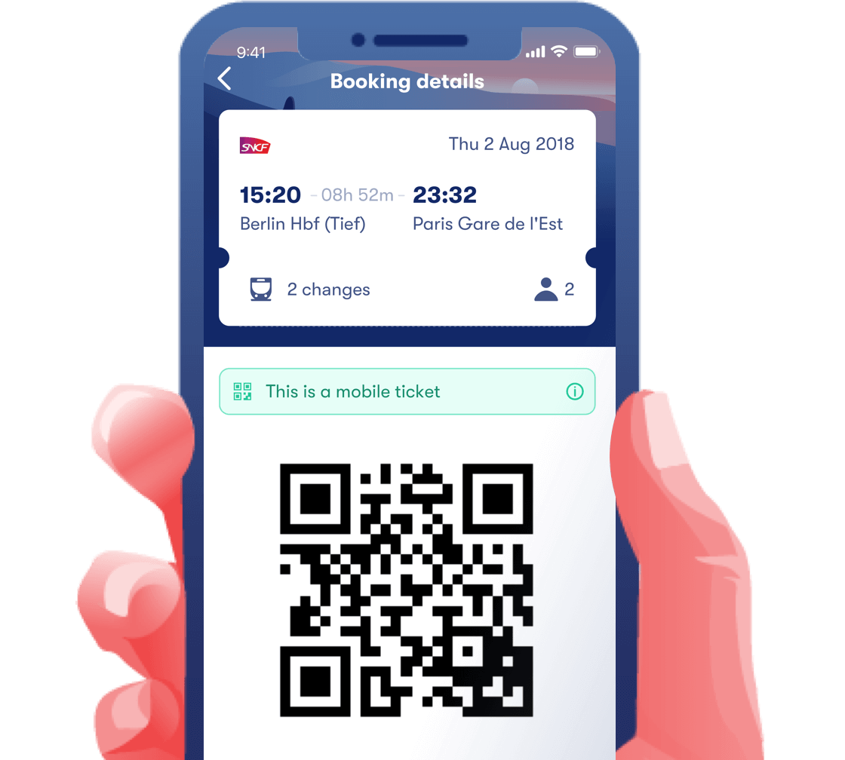
Task – identifying target users
Consider a train travel application that provides features like electronic tickets.
Your aim is find ways to improve this application.
Discuss in groups and determine the 2 important characteristics of your target users.

Slide 14
USER STUDY TECHNIQUES

Slide 15
Common user study techniques
Survey
Interview
Observation
Focus group
Golden rule: Do not introduce your own beliefs or ideas!
What should you do before you prepare the questions?
Notes:
What should you do before you prepare the questions? Understand the business context and project objectives.

Slide 16

Survey
A set of questions used to assess users’ preferences, characteristics and opinions.
What are the different sections of a survey?
Introduction, screening questions, survey questions, conclusion and thank you.

Slide 17
How to conduct a survey
Define questions
Create survey
Test survey
Define a set of research questions
Use a tool like SurveyMonkey, SurveyGizmo or GoogleForms
Run it on a subset of users
Launch survey
Run it on whole sample of users

Slide 18
RESOURCES

Slide 19
Online resources
http://www.designkit.org/methods
https://uxmastery.com/

Slide 20
RECAP

Slide 21
Topics discussed
Importance of user study
User selection – target user
User study techniques
Survey

Slide 22
WEEK 3 – PRACTICAl

Slide 23
Video time
Guidelines for surveys:
https://youtu.be/bi2JMRpL9Ik
How to design a survey/questionnaire:
https://www.youtube.com/watch?v=FkX-t0Pgzzs

Slide 24
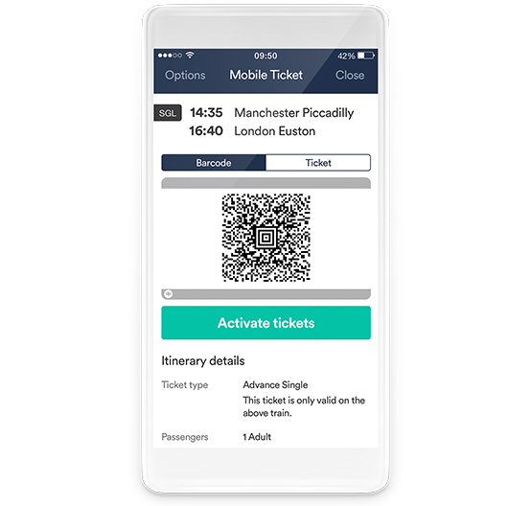
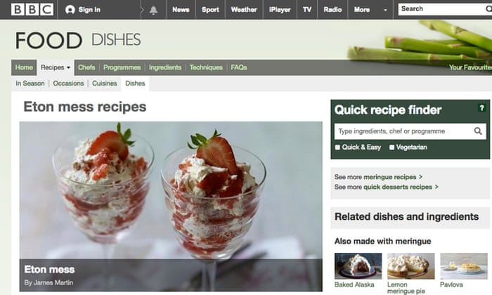
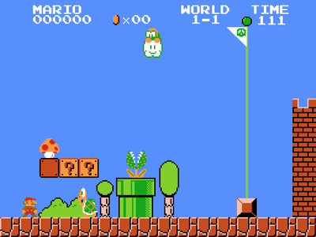
Task – survey
Divide yourselves into groups of 3 and create a survey to study your users about one of the following:
Recipes website
Train travel app
Game

Slide 25
Task – survey…
You can try an online survey tool (SurveyMonkey, SurveyGizmo, Google Forms).
Time: 25 minutes
What was your learning? Present to the class!
Is it easy to frame the questions (MCQ or open-ended)?
Did you cover all important areas of questioning?
Which tool did you choose and why?

Slide 26
Next lesson…
More user study techniques
Interview, observation

Slide 27
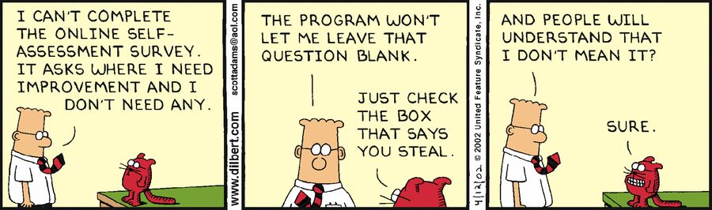
Questions?

Slide 28
Feedback
Lesson
Interesting?
Informative?
Difficult?

